Slide 1
Project Food Sense
Mid-Semester Presentation

Slide 2
Problem Statement
To determine the food quality using nature inspired algorithms on odor and vision data

Slide 3
Nature Inspired Optimized Algorithms - MFO
Inspired from navigation method of Moths
Concept of Moths and Flames
Moths - Candidate Solutions
Flames - Best possible moths obtained so far
Exploration v/s Exploitation

Slide 4
MFO
Fitness measure : distance of moth from corresponding flame
Moth position updation: using logarithmic spiral
Adaptive decrease of no of flames: for convergence
Convergence

Slide 5
Nature Inspired Optimization Algorithms - GSA
Inspired from the Laws of Gravity
Mass of Search Agent (M)
Fitness of search agent (F)
Randomization in Force calculation, position updation

Slide 6
GSA
Mass updation of agents : proportional to fitness
Role of G Updation in convergence
Convergence

Slide 7
GSA + MFO Hybrid
Assign mass concept to Moths in MFO
Communication between moths because of both MFO and GSA
Increase the mass of the fitter moth - GSA
Moths spiral around fit flames - MFO

Slide 8
Hybrid Algorithm (Contd.)
Moth motion is guided by not just by flames but by masses of other moths
Ideally, faster convergence

Slide 9
Hybrid Algorithm Flow
MFO locomotion
Parameter updation
GSA locomotion

Slide 10
Mass Fitness Relationship
GSA - Measure of Fitness is Mass
MFO - Measure of Fitness is distance to fittest moth
GSA works on the premise that fitter agent attracts others towards itself

Slide 11
Mass Fitness Relationship
Hybrid algorithm, exploits this behaviour
Hybrid - Measure of Fitness is distance to fittest moth
Fittest moth has highest mass

Slide 12
Problems Faced - G Updation
Stagnation of algorithm for values in the order of G0
Reason for stagnation - Slow decay of G
1/t vs 1/t² vs b^{t} where b<1 and t = iteration no
Slow decay of G: results in deviation of Moths from optimum value
Updated decay of G to facilitate faster convergence without stagnation
As iterations progress, decrease the GSA motion

Slide 13
Problems Faced - Mass Updation
Mass Updation according to previous mass
Mass(i) = Mass(i) + Fitness(i) / Sum(Fitness(i))
Effective increase in mass of moth was negligible in this case
Replaced with Mass(i) = 1 / fitness(i)

Slide 14
Role of Randomization
Decreases effect of previous values on future values
Significantly important contributor to performance
Example

Slide 15
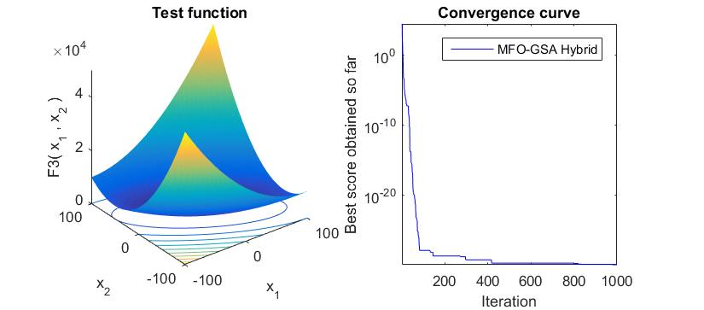
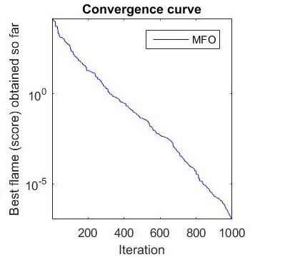
Results

Slide 16
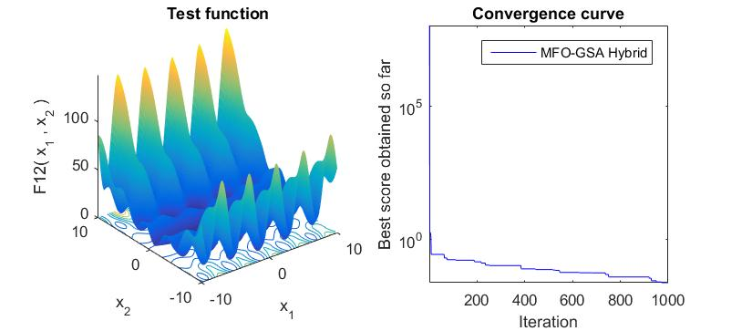
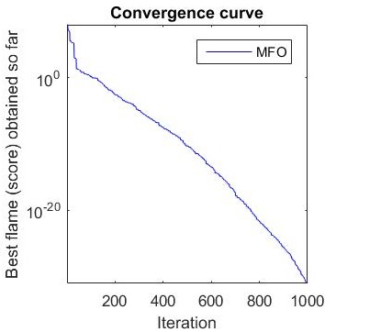
Results (Contd.)

Slide 17
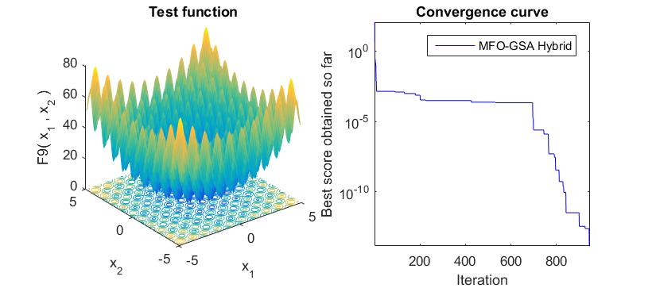
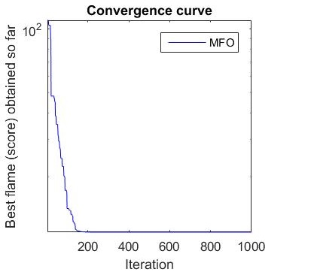
Results (Contd.)

